Slide 1
Mrs. Anna Connell’s
2nd Grade Class

Slide 2
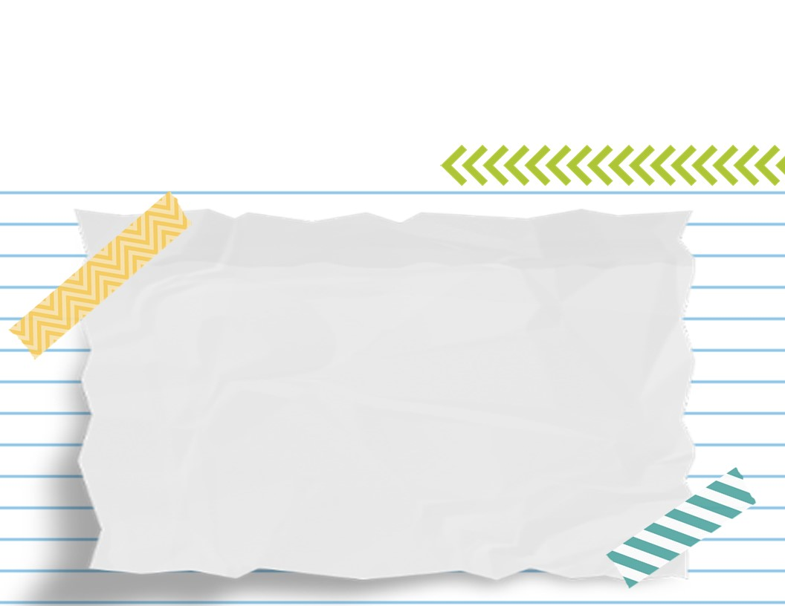
Related Arts and Conduct Calendars
The calendar will be used as a parent-teacher
communication log.
Also, this is where information will be written
regarding any behavior issues. If nothing is written or there is a ☺
on the calendar, then your child received an S for
the day. It is the parent’s please inital
calendars every day.
Related arts schedule will be on the newsletter. Wear tennis shoes daily.

Slide 3
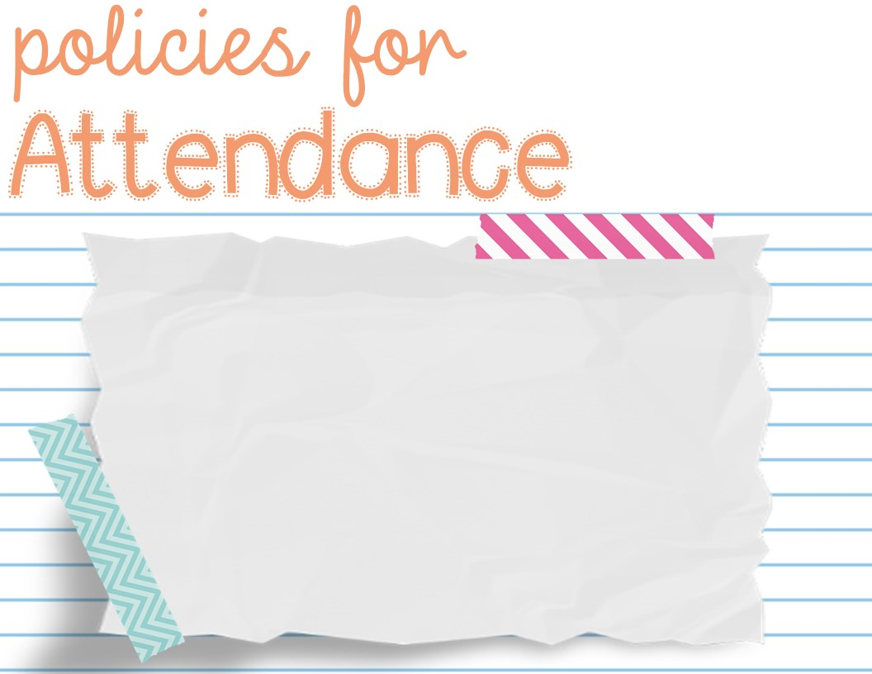
Please refer to the student handbook for details.
Be sure to send a note to school if your child is absent,
checks in or checks out.
All absences will be considered unexcused if
no note is presented to the teacher
within five days of the absence. Please include the
following information
on your notes:
Student’s name, grade, teacher’s name, date, and reason for being absent
Only 6 parent notes will be accepted.

Slide 4
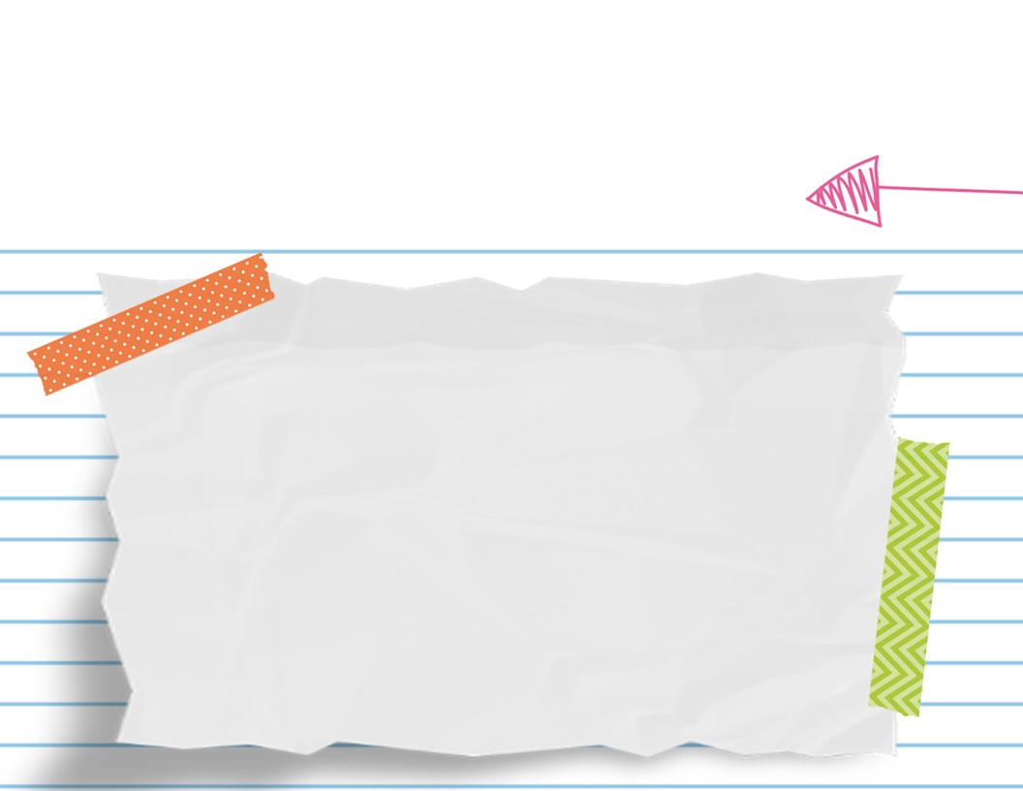
Bathroom
Breaks
Students are given plenty of
opportunities throughout the
day to take restroom breaks, and are allowed
an extra break if needed.
If your child has a medical
concern, please let us know.
We will wash our hands before lunch
and after recess daily.

Slide 5
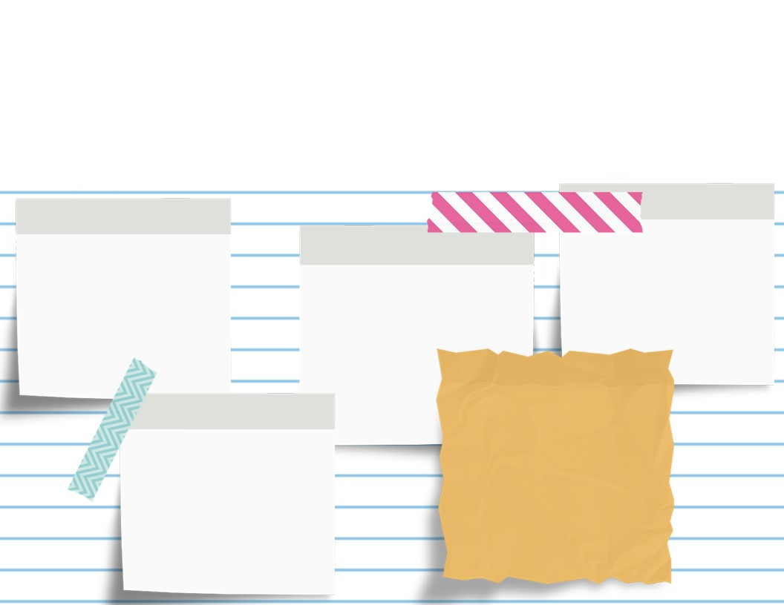
Dismissal
Car Riders: 2:30
SACC: 2:50
1st Load: 2:35
All transportation
changes must be
made in the front
office. Please send a
note for the change.
2nd Load: Upon
arrival of 1st
Load buses

Slide 6
“Family Access”
We strongly encourage every parent/guardian
to sign up for Skyward “Family Access,” which is our
online gradebook system. Graded papers
will be sent home on Tuesdays, but you may
always check “Family Access” to ensure that
all papers are making it home to you. You can
request a “Family Access” application in the
school’s front office. Your application will need to
be completed and returned to school in order
to receive your login information. REPORT CARDS-Not printed

Slide 7
Students will complete graded assignments throughout the week. Students will also be tested monthly on sight word fluency if needed . The monthly sight word list can be found in the student’s binder. Graded papers will be sent home the following week once they have been graded and reviewed. Please sign the graded paper log and return the folder to school the next day your child attends class. All assignments will be weighted equally. Going over work is a huge help when filling learning loss gaps.
Please take note of the grading scale: A: 100-90 B: 89-80
C: 79-70 D: 69-60 F: Below 59

Slide 8
Homework is sent home daily, as needed.
Homework will be in their Homework Folder.
Don’t forget to study for
the spelling test on Friday and all phonics skills/sight words
nightly.
Classwork in the front front does not have
to be returned. Homework we go over will be
in the back of the binder with a ☺.
REPEAT OFFENDERS

Slide 9
Incomplete Work
Students will be given ample time to finish class work. There will be times when incomplete assignments will be graded “as is.” Lost assignments or work that is not turned in will not be replaced and will result in a 0. If this is a struggle with your child, I will let you know! Our goal is to get them out of this habit.

Slide 10
Weekly Spelling Test is on Friday
Sonday Phonics Tests and sight word test weekly
Weekly Spiral Review Quiz is on Friday
Daily Grades
Grammar Tests
Comprehension review
Focus on fluency and comprehension

Slide 11
Addition and Subtraction
Daily grades
Study guides and unit test

Slide 12
Money
When you send money to school, please
always send exact change. We will not be
able to provide change. If you have more
than one child in the school, you should not combine funds into one check. Please
label any money that is sent to school.
Money should be in the zipper pouch of
the student binder.

Slide 13
Newsletter
Newsletters will go home in your student’s binder every week. The newsletter will include information specific to that particular week such as weekly topics, etc. Newsletters will also be available on the class DOJO.

Slide 14
Snacks
Please send a snack with your child each day. Please be mindful that we may be working while eating. Messy snacks will NOT be permitted. Microwaves and refrigerators are NOT available for student use. Water is recommended.

Slide 15
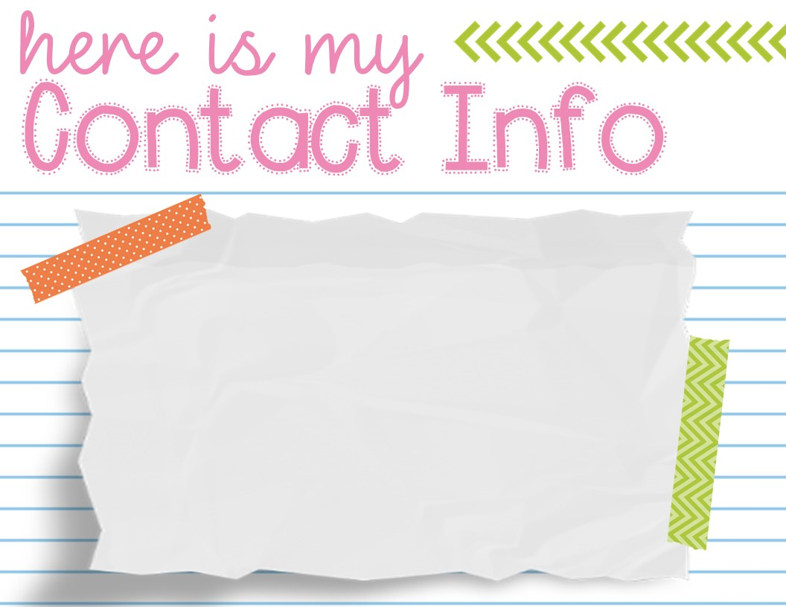
aconnell@tipton-county.com
Class dojo is always a
great way to reach me.
901 581 1958
If I do not respond, call the school if changes in transportation.

Slide 16
Respect the space
of others
Follow directions
respectfully
Be respectful
To others
Be SAFE!
Be responsible

Slide 17
Rewards and Consequences
Verbal praise
Happy Notes, Texts, and Calls home
Treasure Box
Let’s talk about…
“Natural Consequences” and
Conduct Grades

